Slide 1
International Center Joseph Wresinski presents :
« JOSEPH »

Slide 2


The CHILDHOOD
and YOUTH of
FATHER JOSEPH WRESINSKI

Slide 3
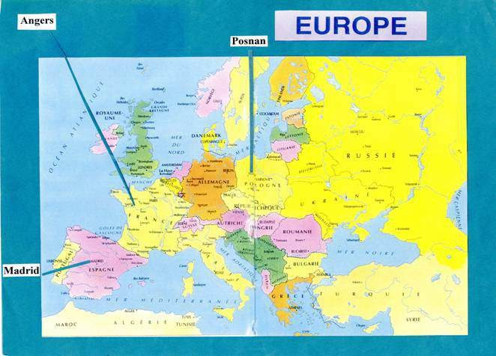
Origin of Wrzesinski parents
Joseph’s father was originally from Poznan in Greater Poland, a Polish region occupied by Germany at the time of his emmigration.
Wladyslaw Wrzesinski met his wife, Lucrecia Sellas-Lopez, in Spain.

Slide 4
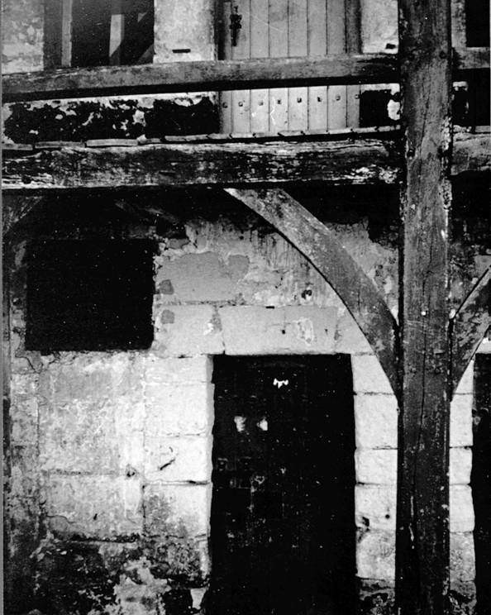
1914 - Internement Camp Saumur, France
The Wrzesinski family were kept confined at the fort in Saumur, a wartime internement camp.

Slide 5
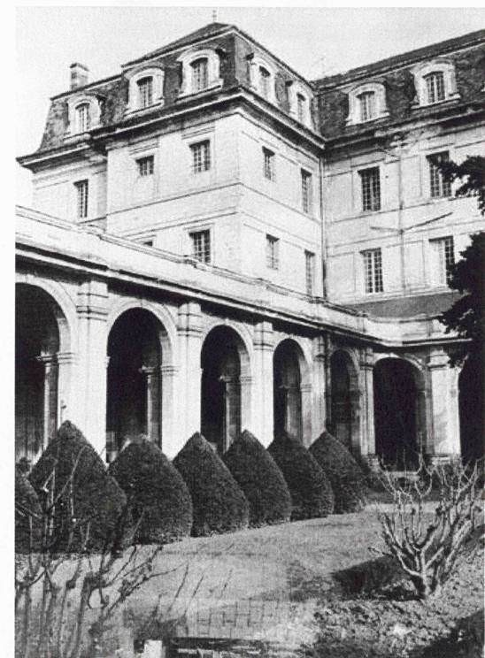
1917
Birth of Joseph in Angers
Joseph was born in the internement camp which was set up in the old Abbey Saint-Serge.

Slide 6
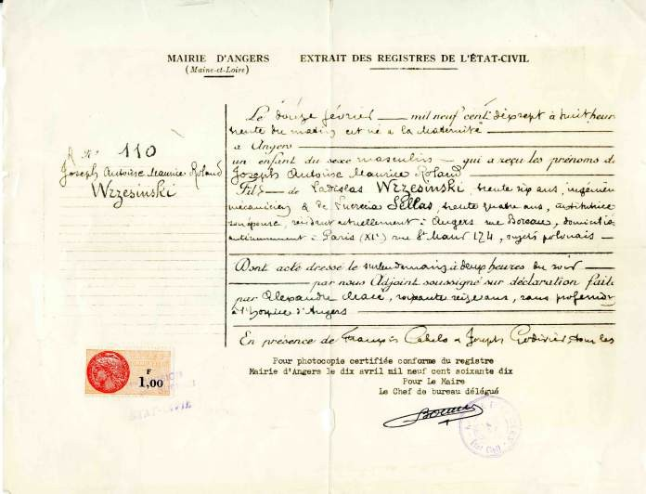
Father Joseph’s birth certificate shows he was born on 12th February 1917

Slide 7
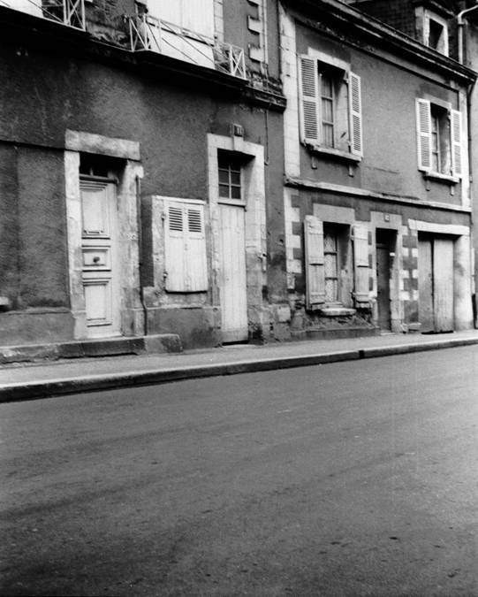
1924
Saint-Jacques street in Angers
After the war, the Wrzesinski family found refuge in a disued forge in the neighbourhood of Saint-Jacques in Angers (France).

Slide 8
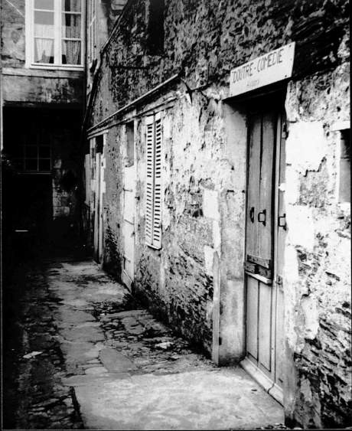
The court yard
Joseph : «It was nearly always cold in our house. One of the partitions was made of crates covered in wrapping paper. When the paper split, the wind would lash at us. »

Slide 9
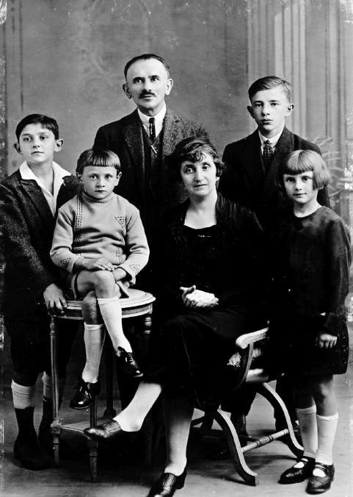
1928
Wrzesinski family
Joseph is standing up at the left of the photo.

Slide 10
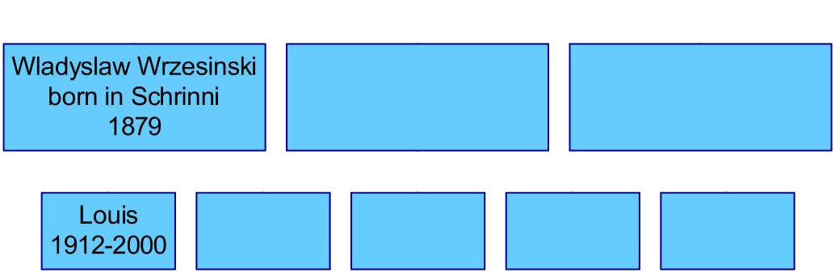
Wrzesinski family

Slide 11
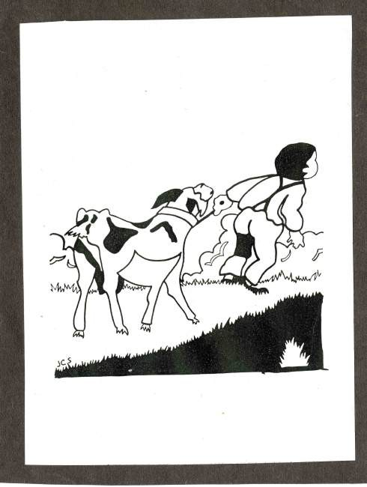
1921
« I was involved in the struggle to find, food from a very early age. »
Joseph keeps the goat
« I was four years old and it was me who led the goat up to the field. This goat would feed us, my newly born little sister and the rest of us »

Slide 12
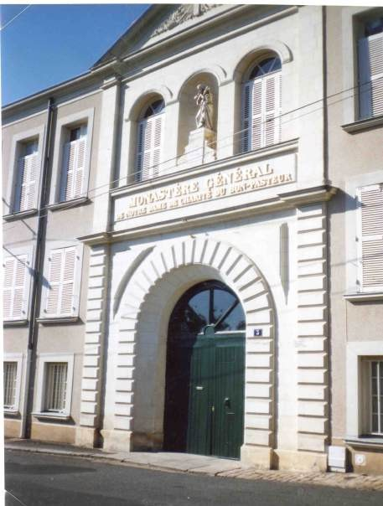
Joseph serving mass at the local church.
He started at an early age to serve the second mass at 6 am at the chapel of the Sisters of the Good Sheperd.
Joseph :
« For serving the mass, I would have the right each day to a big bowl of milky coffee with some bread... »

Slide 13
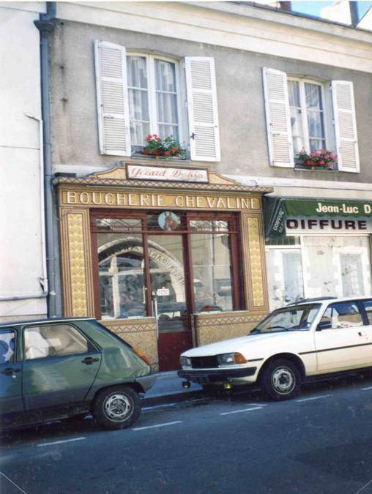
Joseph works for a butcher.
Joseph :
«So, at the age of 7 I had found another
job ; I was running errands for Marie- Louise, the butcher, who in return gave me 2 francs of horse meat nearly every day »

Slide 14
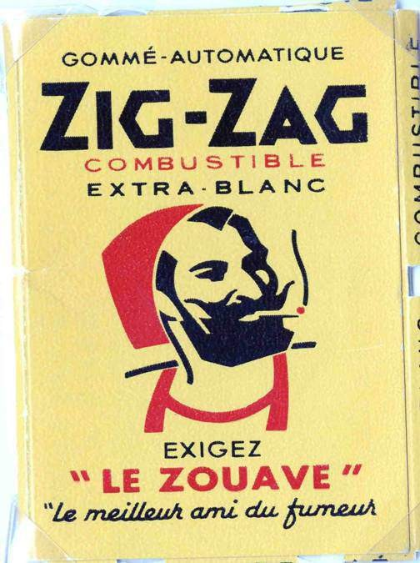
The family works.
Louis Wrzesinski :
« Putting the Zig-Zag paper together was a real knack from the point of view of speed because it was badly paid. It was hard work and it needed skillful fingers to succeed. It was necessary not to fall asleep. We were helping my mother. »

Slide 15
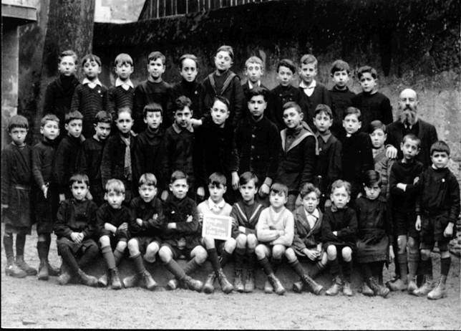
1929 - Certificate of basic education
Joseph achieving his school certificate ? For the teacher there was no question about it !
«My mother knew I wasn’t stupid. It was her who enrolled me and pushed me to complete it.»
And Joseph succeeded !

Slide 16
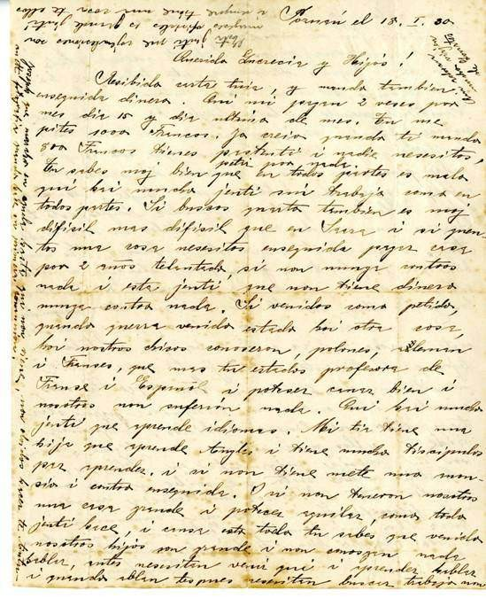
18 january 1930 : From Poland, Wladyslaw Wrzesinski writes to his wife Lucrecia
Wladyslaw :
« It’s great that Joseph wants to study and because of this, I’ll send the money you have asked for. »

Slide 17
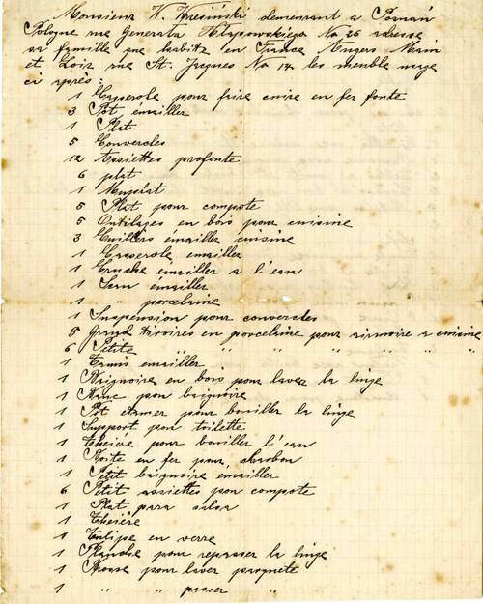
He attached to his letter a list of things that he would be sending to Angers : a black piano for Antoinette, a violin for their sons.

Slide 18
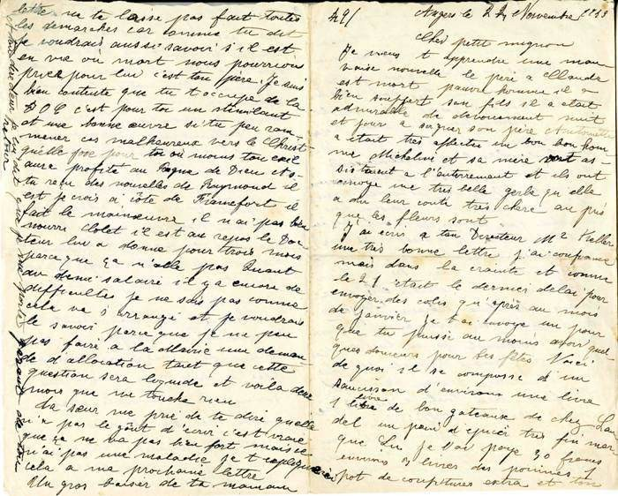
1943
A letter from Lucrecia, the mother of Joseph
Lucrecia writes to her son Martin, the youngest.

Slide 19
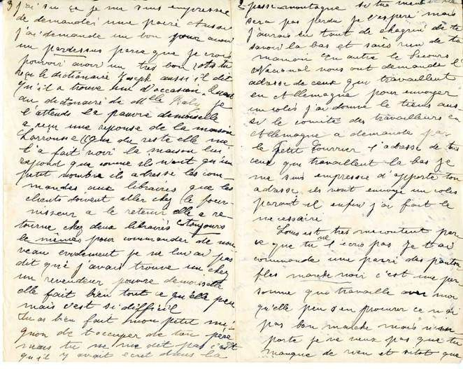
Lucrecia to her son Martin :
«Do all you can, I need to know if he is dead or alive, we are praying for him, it’s your father.»

Slide 20
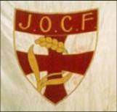
1933
Joseph at JOC (YCW)
Whilst he is training to be an apprentice confectioner, Joseph is taken by a friend to a JOC (Young Christian Workers) meeting. He is soon in charge of doing the minutes !

Slide 21
In Nantes, the JOC group investigates the tuberculosis outbreak which was spreading rapidly amongst destitute workers.
Joseph : « I said to myself that deep down these young people are my friends, they are like me. They are trying to understand, they are trying to do something »

Slide 22
« I committed myself to JOC and threw myself into looking for young people on the Fosse Quay who had been affected by tuberculosis. I went to see them. Just like that. At the same time we made a petition. It was in this way that I started to practise (in a religious sense), to pray. »

Slide 23
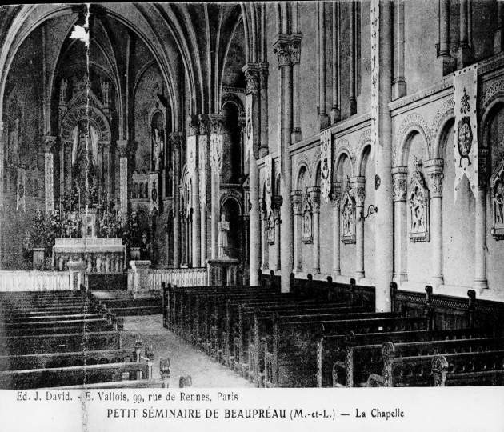
« And one fine day I said to Father Gerbaud, Priest of JOC : Listen, why shouldn’t I become a priest ? »

Slide 24
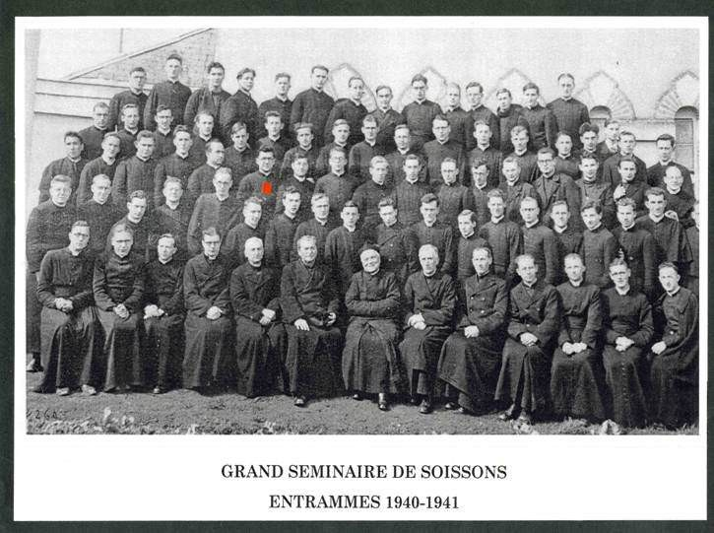
1940-1946
Training to become a priest at the seminary of Soissons
The family of a nun from the Sisters of Good Sheperd community pays for Father Joseph’s studies at the seminary.

Slide 25
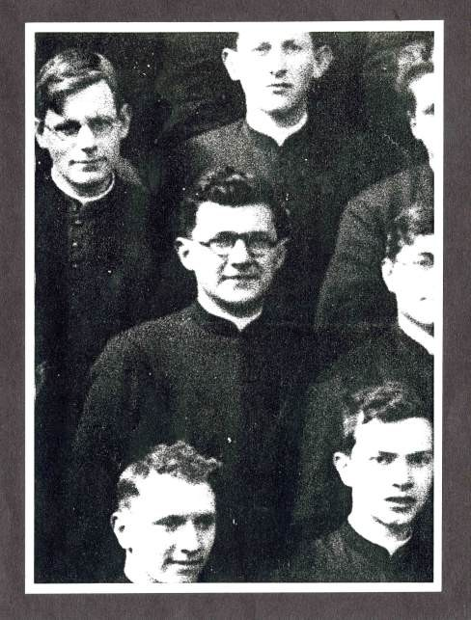
1940-1941 :
seminary of Soissons is relocated to
The
Entrammes due to the war.

Slide 26
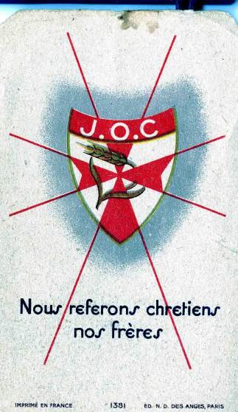
1946
Ordained in the priesthood
«Christ made me his priest on the 29th June 1946 at the cathedral in Soissons. » Joseph Wresinski

Slide 27
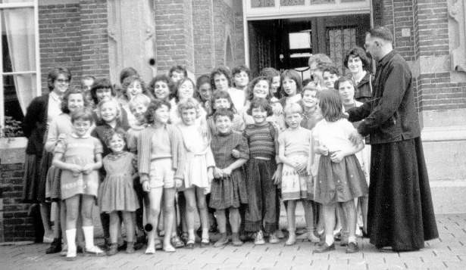
1946-1950
Vicar in Tergnier
Father Joseph with children from Bible class

Slide 28
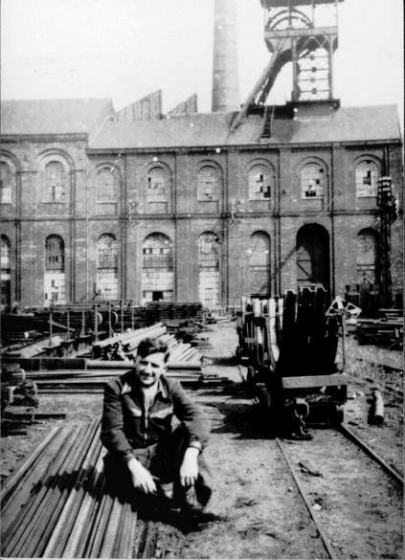
1946-1950
Vicar in Tergnier
In 1950, Father Joseph works for one month at the mine of Sesseval.

Slide 29
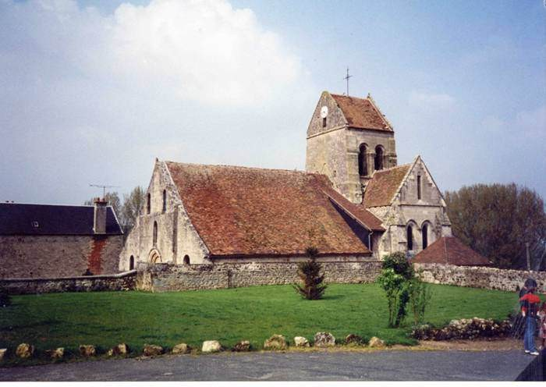
1951-1956
The parish at Dhuizel
Father Joseph is the priest for this parish before his assignment to Noisy-le-Grand.

Slide 30
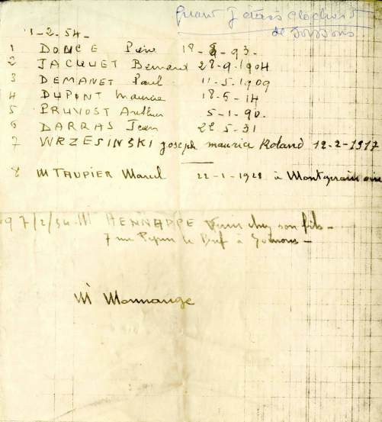
These are registered names of the homeless men whom Father Joseph stayed with at the refuge of Soissons. He had left his post at Dhuizel for four days in order to discover more about their lives.

Slide 31
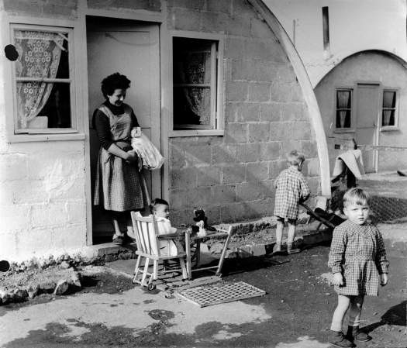
14 July 1956 :
Father Joseph arrives
at
the Camp in Noisy-le-Grand
«The families that I met reminded me of the poverty of my mother. The children who bombarded me as I arrived, were my brothers, my sister, me, 40 years earlier at Saint- Jacques street in Angers»

Slide 32
ATD Fourth World Movement
2 rue de la Gare - 95560 Baillet-en-France June 2007
Made by Laurence Bervas from documents provided by Erpicum and Eileen Donovan
Gabrielle
Documents and Photographs : International Center Joseph Wresinski, Departmental archives, Angers
Music : Antonin Dvorak Symphony n°9 in E minor the New World, Movement (largo)
From
₂nd
© ATD Fourth World - ICJW - June 2007

